Slide 1


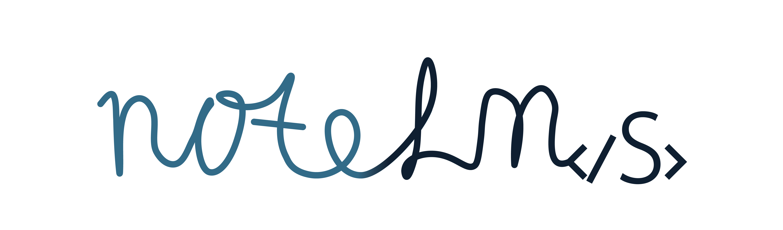
NoteLMs: The three-model organization framework for student notes
Yan Levin
yl-2010@outlook.com
notelms.com
July 2026
Notes:
Citations:
Programs such as onenote, etc
Reports of ppl struggling with those apps

Slide 2
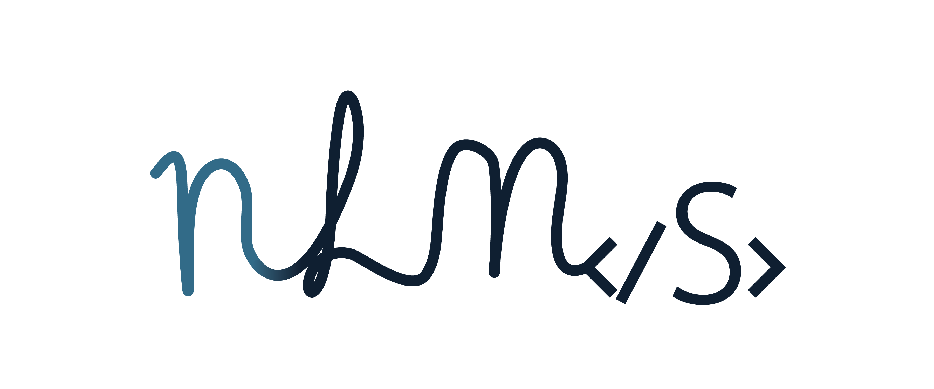
Problem
Notes chaotic & rarely-reviewed
w/ digital tools still requires manual organization
Notetaking w/o tools requires physical organization
Notes:
• Student notes are often chaotic and rarely reviewed
• Notetaking without tools requires manual, physical organization
• Existing tools still require manual organization
Add no tools world in addition to existing tools
Highlight existing world more, frame as half-efficient studying
Split problem and solutution into diff slides, add graphics
Highlight problem more

Slide 3
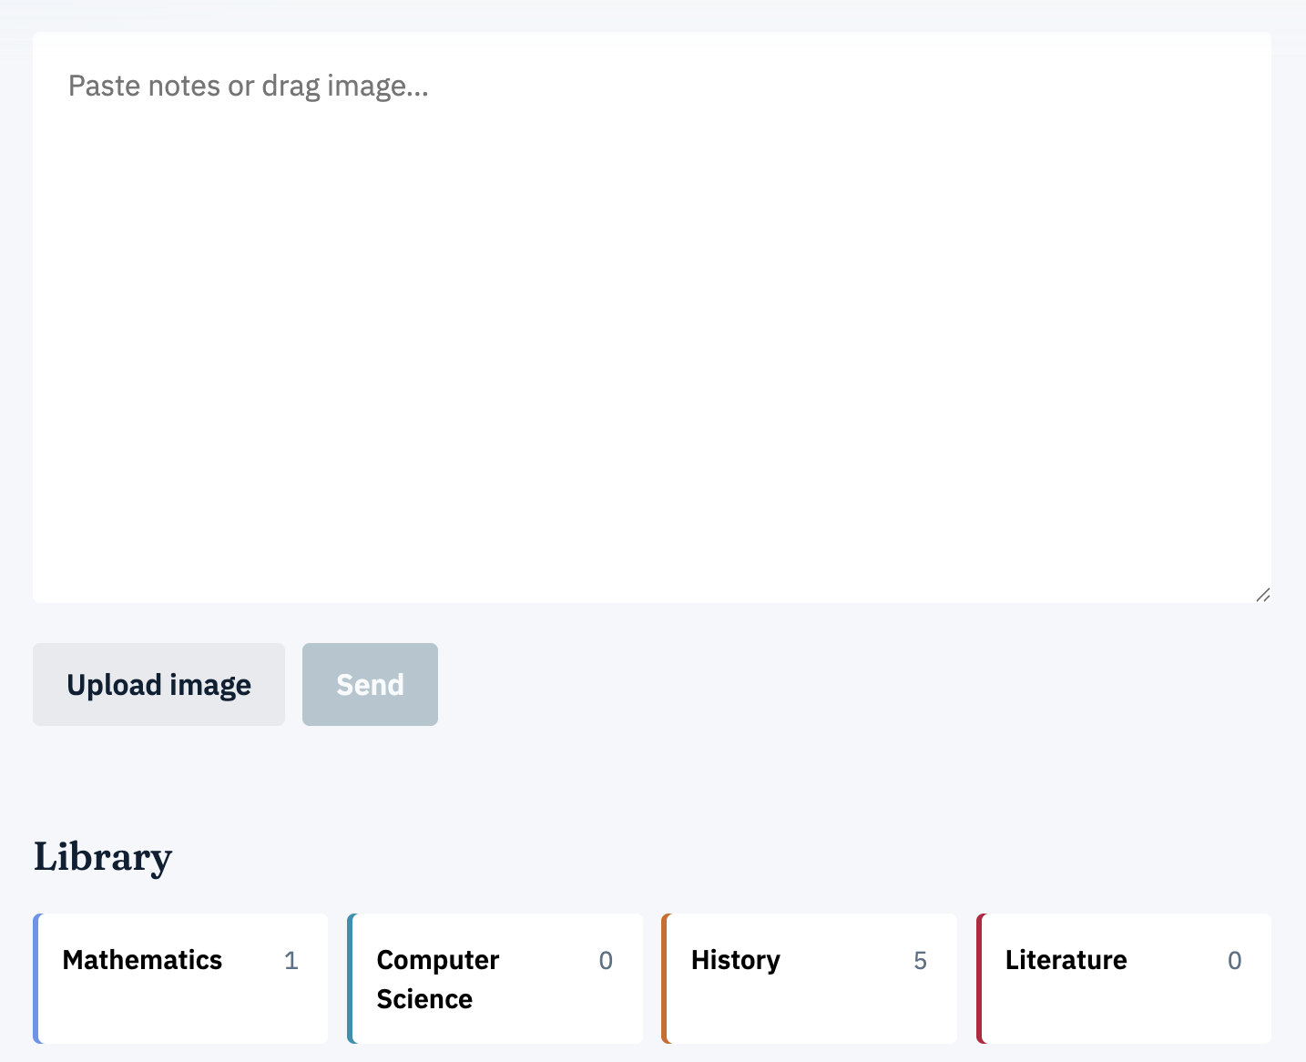
Solution
• NoteLMs auto-classifies into folders, HTML-formats notes, and reads notes aloud for review
• This saves students’ time, making them more likely to review their notes in the future
• Three models compete; accuracy scored in real time
Notes:
Add no tools world in addition to existing tools
Highlight existing world more, frame as half-efficient studying
Split problem and solutution into diff slides, add graphics
Highlight problem more

Slide 4
Introduction
• Website that auto-sorts and formats student notes
• Fully-functioning, live website, free to use
• If a software solution is capable of solving this:
Are LMs capable of categorizing notes into subjects?
If so, which LM is best?
• We have found that fine-tuned BERT is the most accurate LM at subject classification.
Notes:
Add: “are we able to create a software solution to solve this?” if so, it shd be able to ansewr those two qeustions

Slide 5



Related Products
• Microsoft OneNote
• Apple Notes
• Physical notebooks
• All require manual organizing and formatting

Slide 6

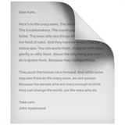


Conceptual Solution
• Auto-organizes and formats the user’s notes.
• Input: plain-text notes or note images
• Output: Classify subject → place in subject folder
• Output: Auto HTML-format for readability
• Output: Natural AI readout
Image
Text
Formatted notes
Natural speech
Sorted notes
Notes:
Add a more higher-level solution before this slide
Sentence from before, but flip it to what we’re doing
Highlight automatic ness

Slide 7

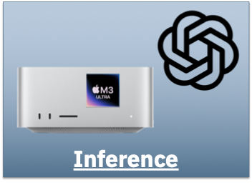
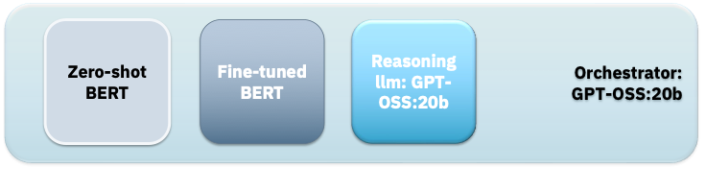
Implementation
• Vercel-hosted web app + Cloudfare tunnel
• 3 language models for classification
Zero-shot BERT, Fine-tuned BERT, GPT-OSS:20b
Inference on Mac Studio, M3 Ultra w/ 96 gb unified memory
• Image -> text is done through OpenAI API key

Slide 8
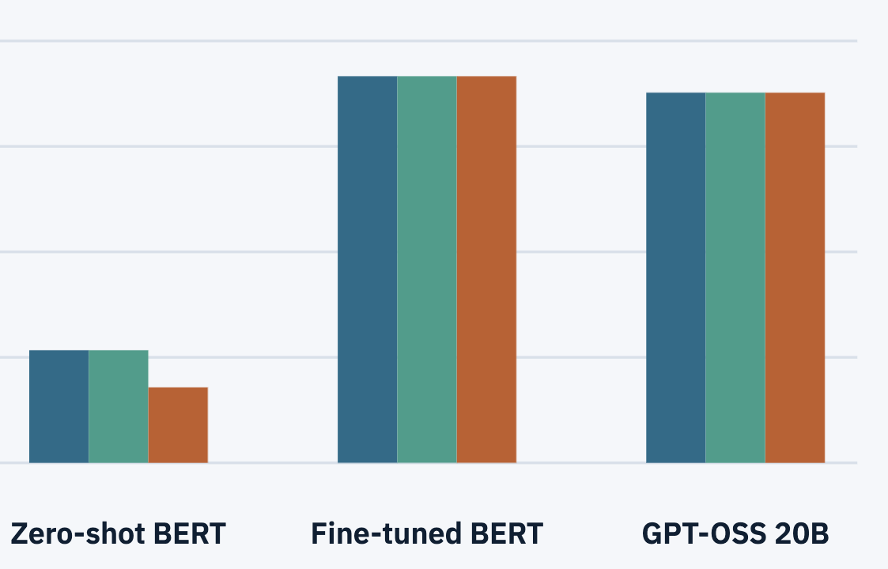
Evaluation
• Goal: measure classification accuracy
2,000 original eval runs
Models evaluated with every use of NoteLMs
91.7% accuracy, proves that machine can organize well for user
• Threat: limited non-diverse data
Solution: introduce diversity by
drawing in real-world user data
Notes:
We already have over 30 evaluations of user data
Another threat is still
Say that the biggest problem is accuracy, connect classification accuracy to original problem

Slide 9
Site Demo
https://notelms.com/

Slide 10
Conclusion
• Problem: students don’t review their notes because of no organization
• Solution: we fully sort and format their notes for them
Built-in chatbot answers questions about notes
Voice reads aloud notes when it’s time for test
• Research: compares and score three models live, with every new input
• Future work: local image to text, comparing between different LLMs
Notes:
reiterate problem, solution, and what the eval showed
Better visuals, more attention-grabbing
Add contact

Slide 11
Contact
• Yan Levin
• yl-2010@outlook.com
• yanylevin.com
Notes:
reiterate problem, solution, and what the eval showed
Better visuals, more attention-grabbing
Add contact

